Slide 1

Before your group visits Chelmsford Museum for our Stone Age to Iron Age session take time to use this powerpoint with your pupils.
As you go through the presentation our robot character will help your pupils develop the skills and knowledge they will need to make the most of the session and inspire questions to explore when they visit.
Encourage your pupils to share ideas with ‘a neighbour’ before you click to reveal answers.
Enjoy

Slide 2
Stone Age to Iron Age
at Chelmsford Museum
Hi and welcome to Chelmsford Museum. This is a great place to discover lots about the past.
When you visit you will need to work like an archaeologist and investigate lots of different objects. Let me help you practice the skills you will need to equip you for your visit….

Slide 3
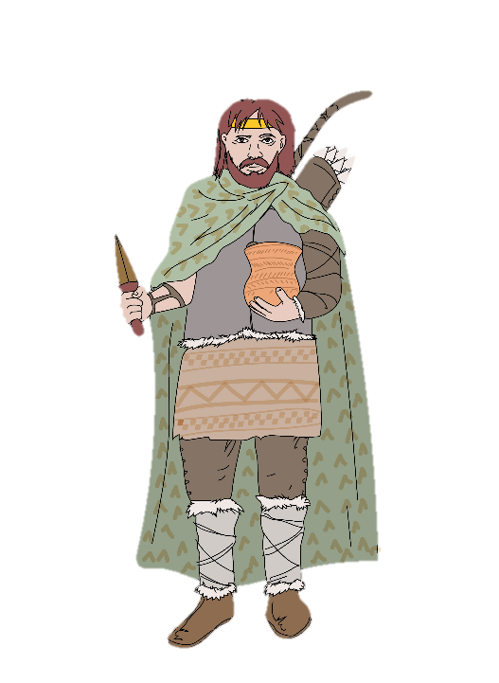
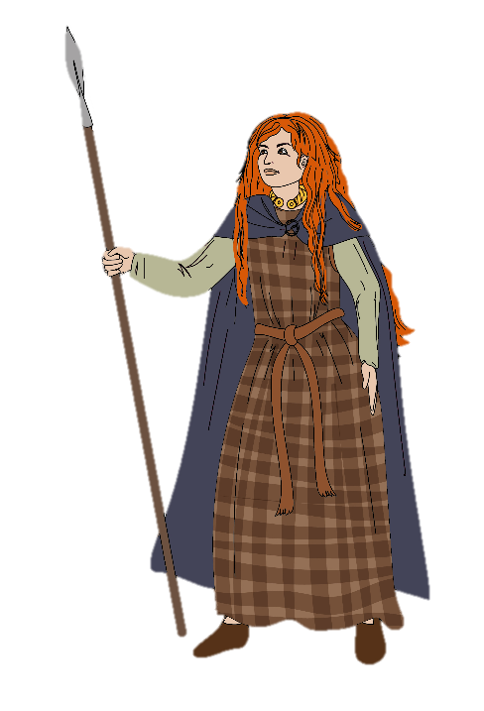
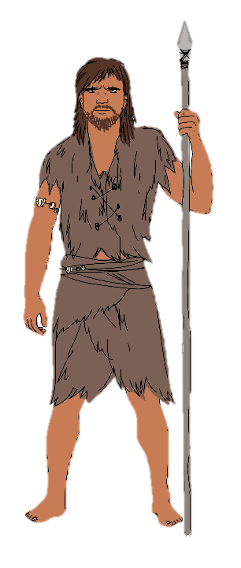
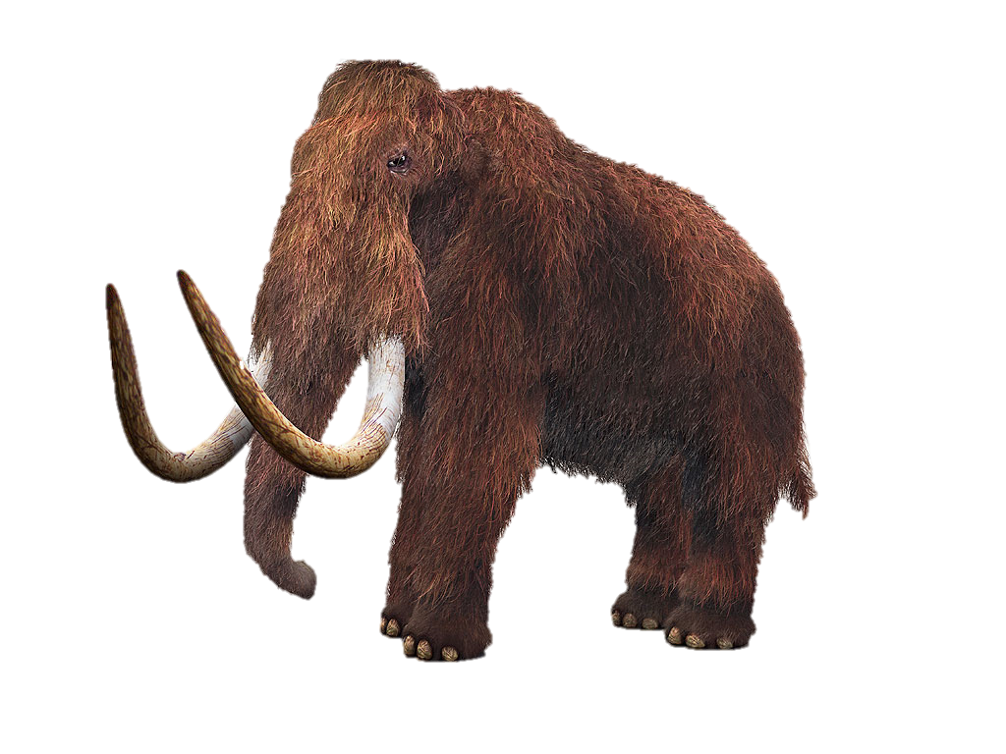
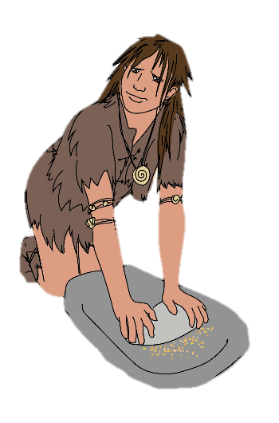
Lets travel back in time….
The time from the Stone age to Iron Age is known as prehistory
or prehistoric times. It means before there were written records.
BRONZE AGE
IRON AGE
STONE AGE
?
?
?
?
?
Palaeolithic
Mesolithic
Neolithic
The Stone Age lasted a very long time and is split into 3 periods

Slide 4

How do you think can we find what out what life was like at this time if they didn’t leave any written records?

Slide 5
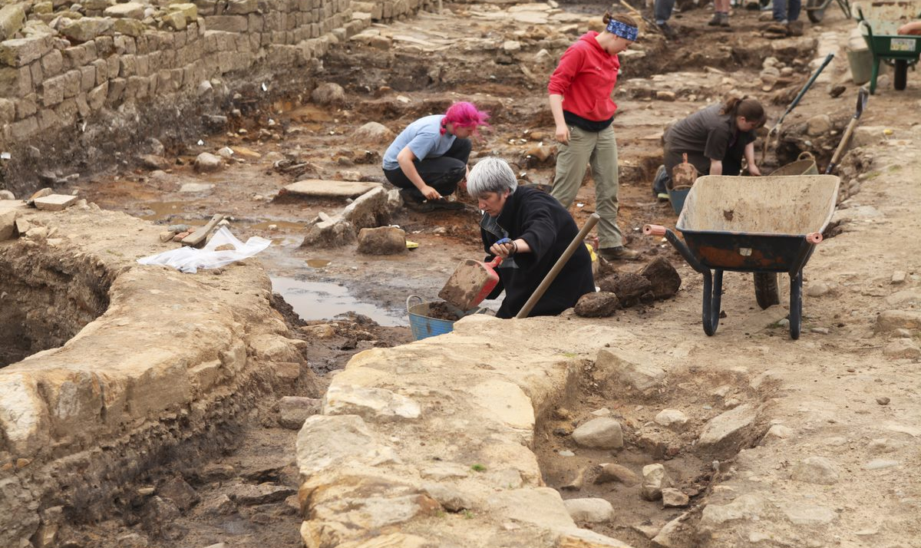
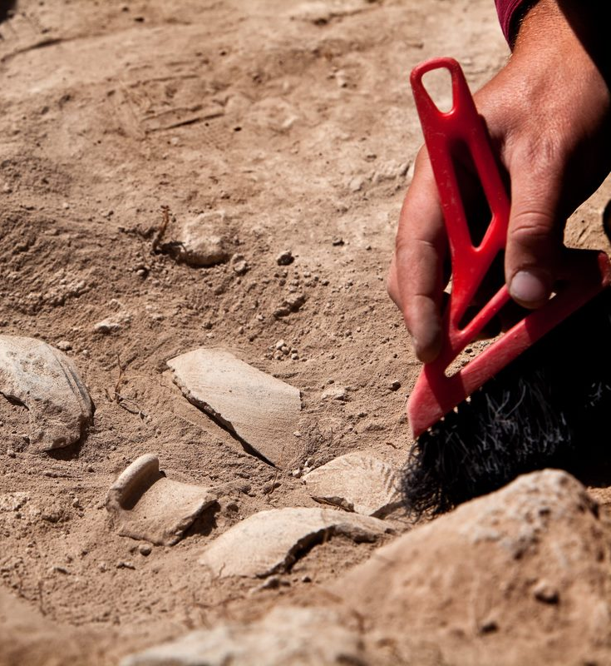
Archaeologists often find out about the lives of people from objects they find buried underground.
But not everything survives. Organic materials, like plants, will slowly rot and disappear. Only inorganic materials like stone will survive.

Slide 6
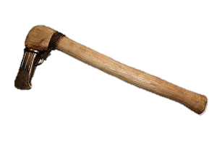
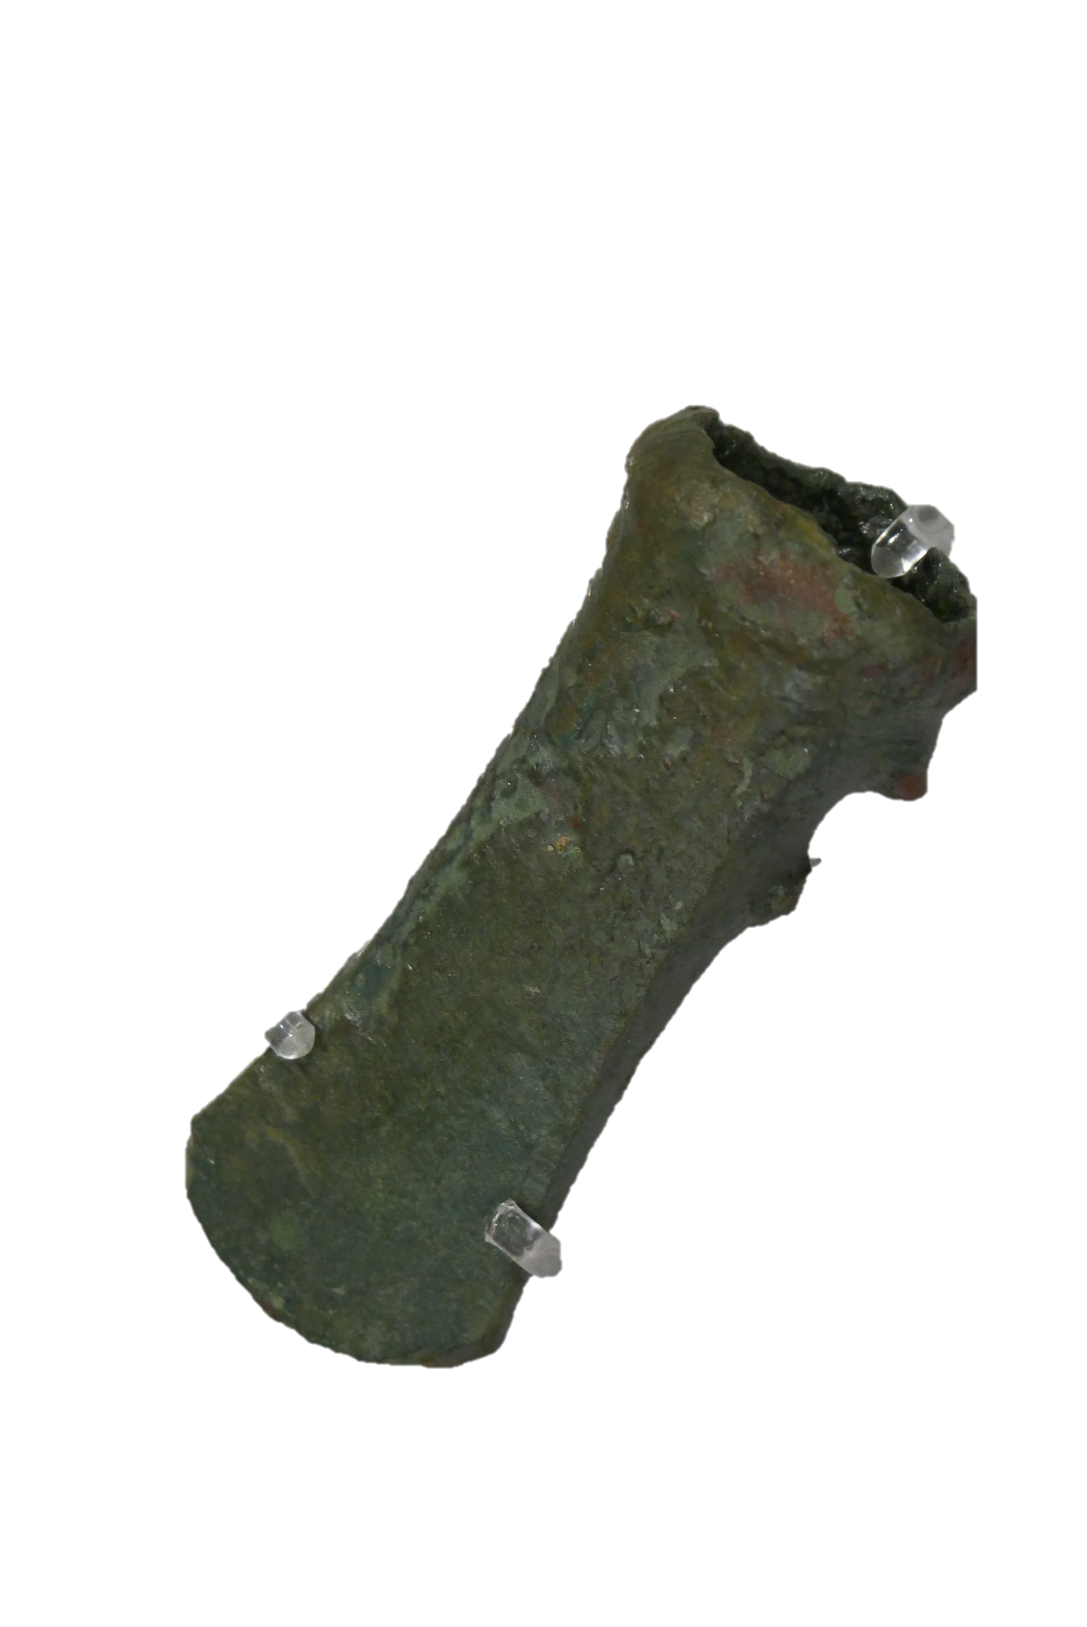
What will survive buried underground?
Wood and leather will rot and disappear
(unless ground is water logged and there is no oxygen)
Metal
will survive

Slide 7
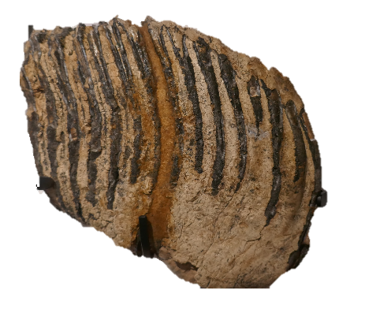
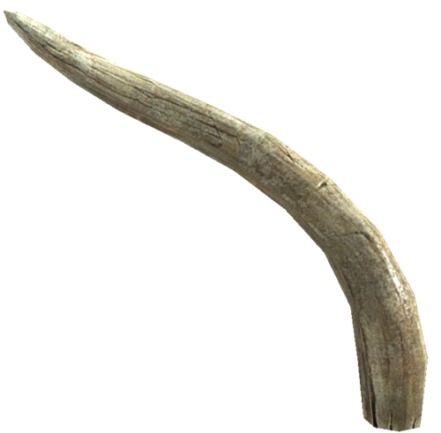
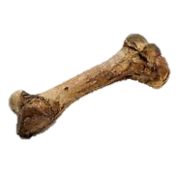
What will survive buried underground?
Flesh will rot and disappear
Bones, teeth and tusks
will survive

Slide 8
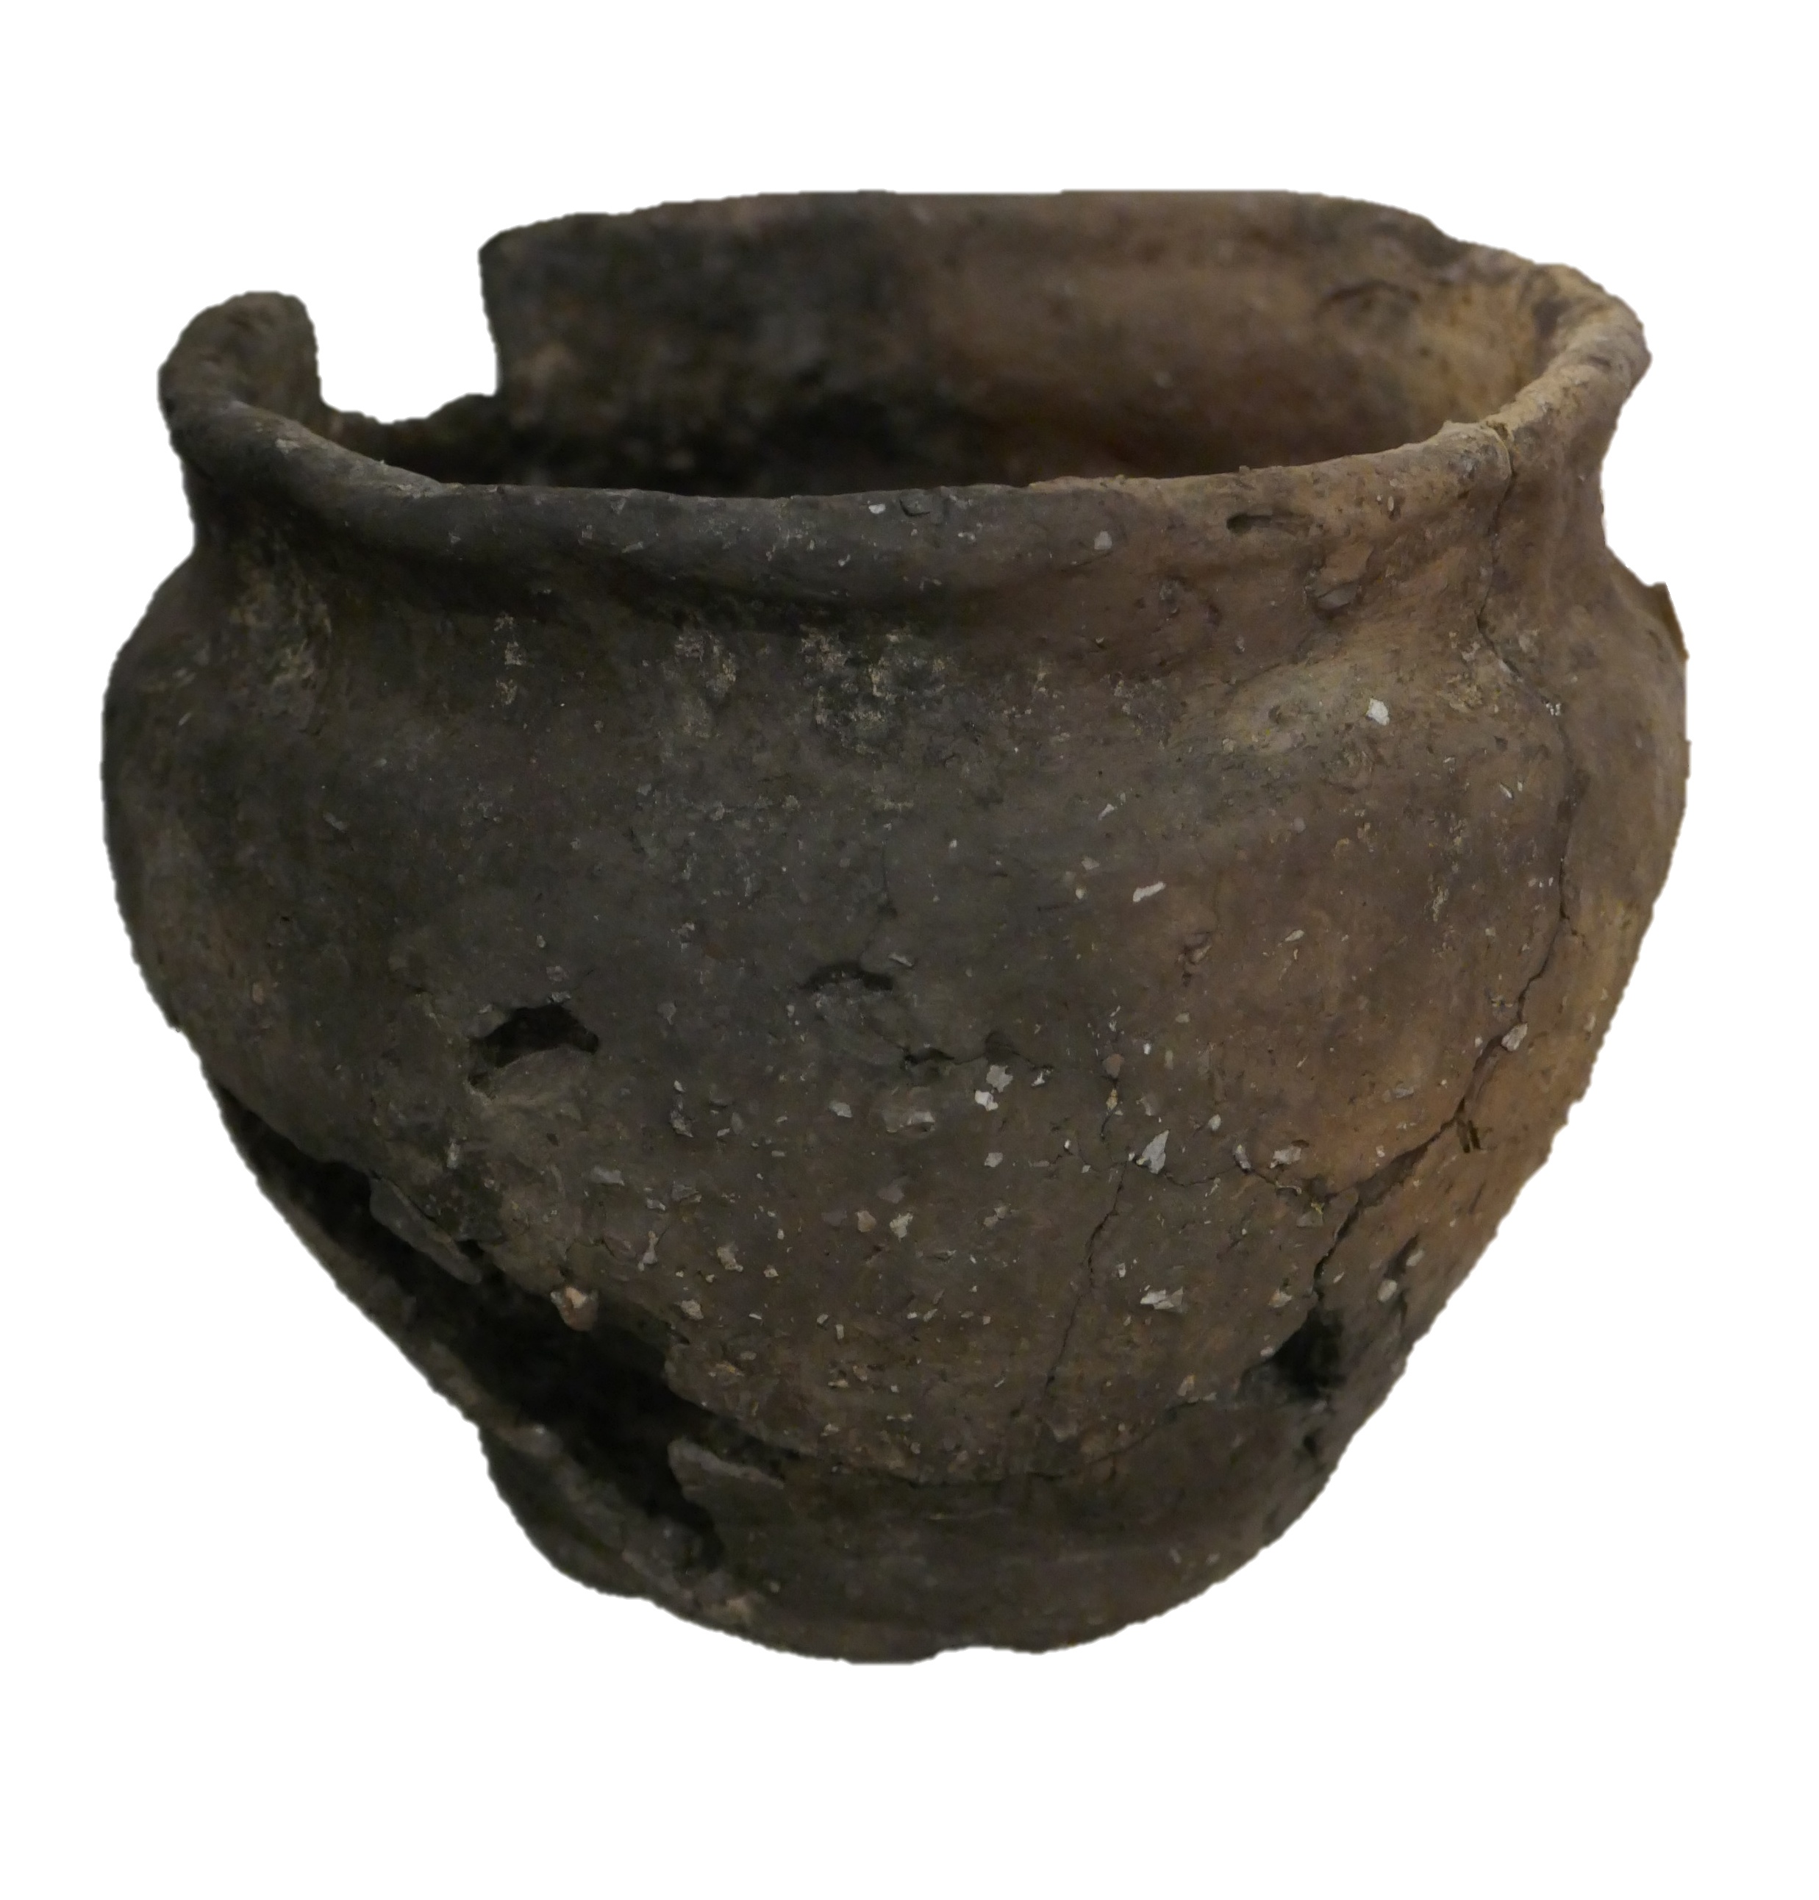
What will survive buried underground?
Pottery
will survive

Slide 9
Becoming an ‘Object detective’
Archaeologists are like ‘object detectives’. They look closely at the things they find and ask lots of questions to find clues or evidence about the objects and the people they belonged to.

Slide 10
Ask questions and see what can you discover about this object.
Do you think it has been made by someone? How?
What do you think it is
made from?
What do you think this object was for?
What clues make you think this?
Do you think this is the whole object?
This is an Iron Age clay pot. It was hand made and would probably have been used for storing food.

Slide 11
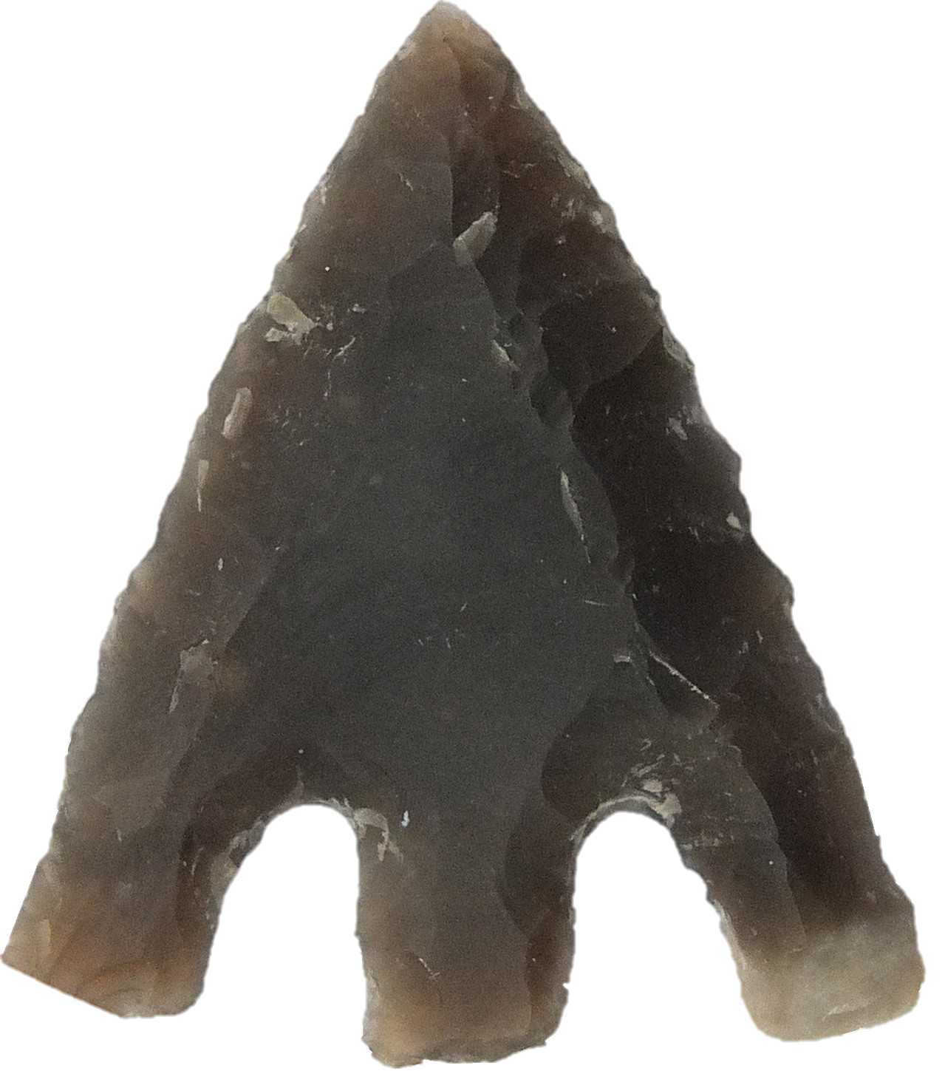

What can you discover about this object?
Do you think it has been made or shaped by someone? How?
What do you think it is
made from?
What do you think it was used for?
Why do you think this?
Do you think this is the whole object?
If not what do you think the whole object looked like?
This is a Stone Age flint arrow head. It was shaped by hitting the flint with an other rock. The wooden shaft and binding have rotted away.

Slide 12
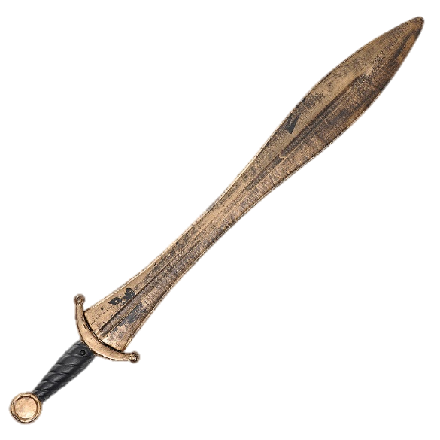
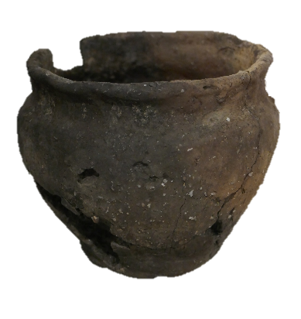
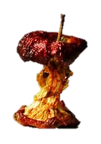
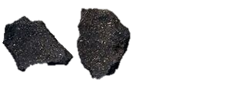
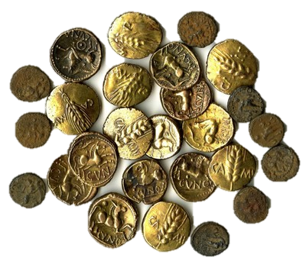
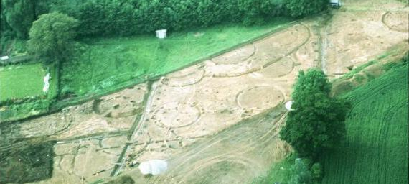
Why do you think things may have been buried?
things may have been ‘given’ as a gift to the gods
they may have been thrown out as rubbish
they may have got lost or been abandoned like this Iron age settlement
valuable treasure may have been buried to keep it safe - there were no locks on doors

Slide 13
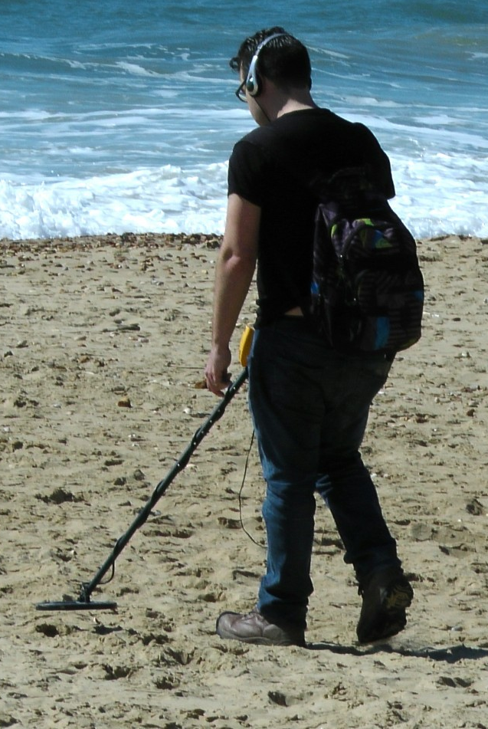
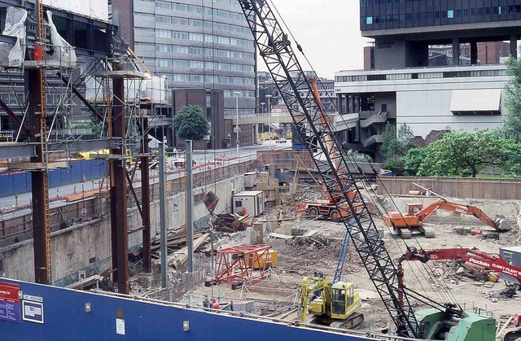
But how do archaeologist know where to start digging?
Sites may be discovered by accident when developers are digging foundations for new buildings and roads.
Metal detectorists may find metal objects
Sometimes the foundations of buildings buried underground can be seen on aerial photographs

Slide 14
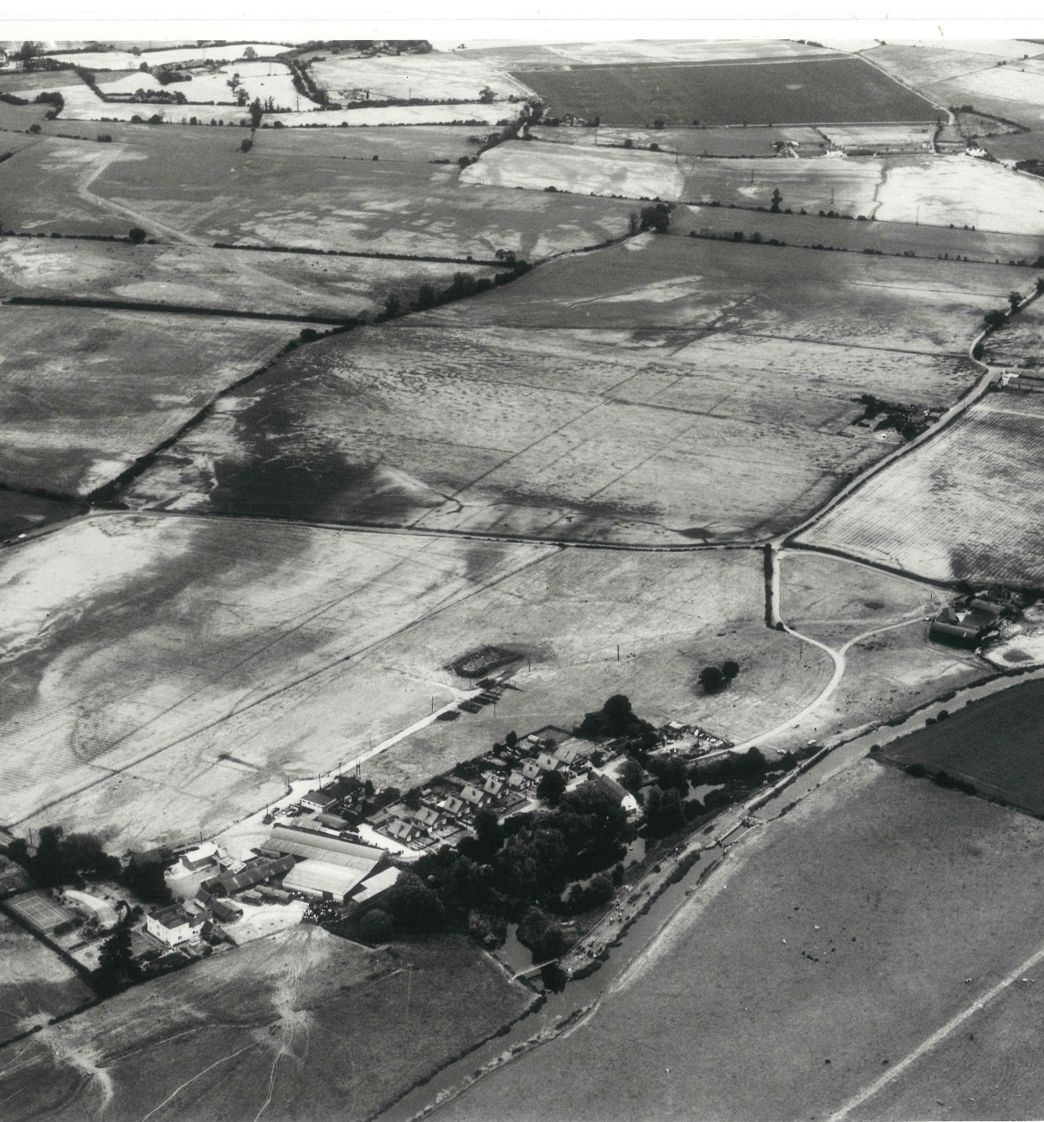
This long rectangular ditch was part of the Springfield Cursus.
Archaeologists think it was a spiritual Stone Age site with a circle of wooden posts like the stones at Stonehenge.
It stretches from ASDA carpark in Chelmer Village.
Look closely at the photo.
Can you see a long rectangular shape in the fields?
What do you think it might have been?

Slide 15
At Chelmsford Museum
You will be able to use your new ‘object detective’ skills
to discover much more when you visit Chelmsford Museum.
Come with lots of questions and ideas. See you soon.

